Slide 1
Advanced Incremental load with Custom Back Date logic

Slide 2
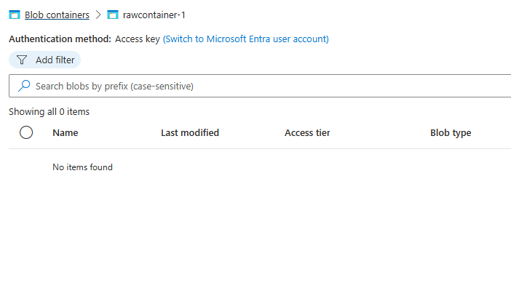
Empty container without any data.

Slide 3
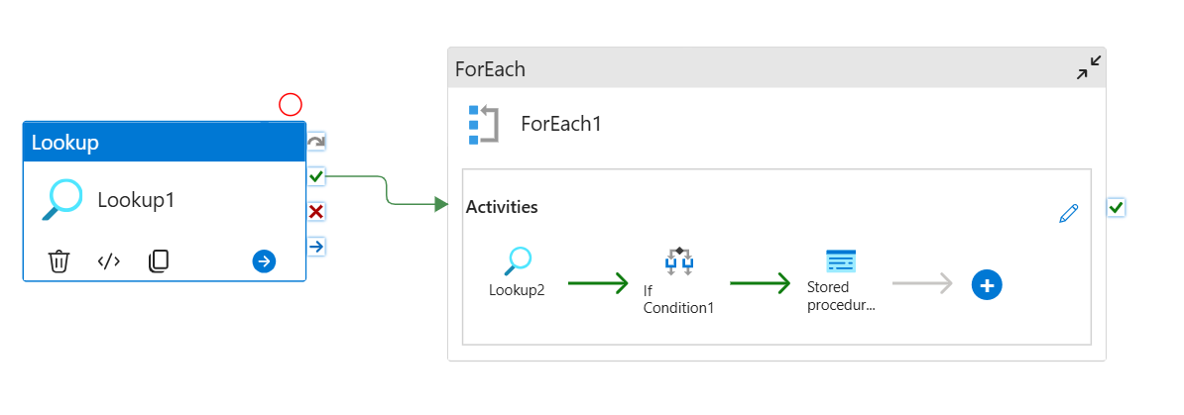

Slide 4
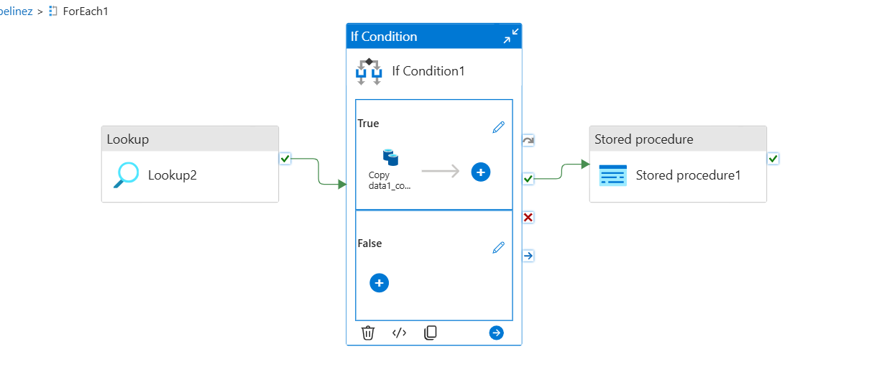

Slide 5
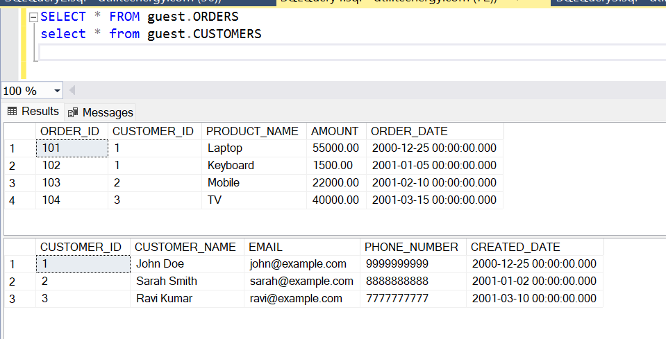

Slide 6
As from the customer and Orders table we have data in the source sql server. I like to get the data from the specifical date. Where this incremental load pipeline has the Back date logic. Where we can get data from particular date.
This pipeline as use for dynamic data loading with the control tables to target sink as azure container.
This pipeline supports incremental data loading as well.
The if activity stop working if there is not new records in the source. Used save the computation cost running the copy activities without any data.

Slide 7
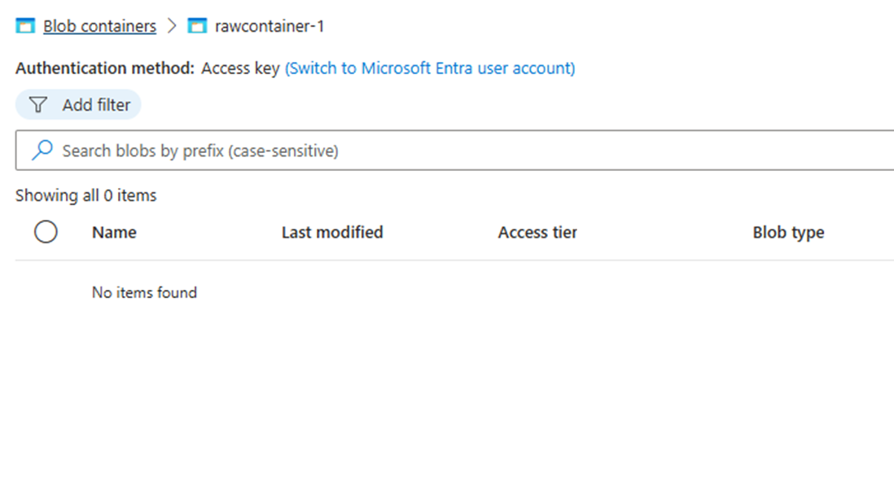
The container is empty without any data..

Slide 8
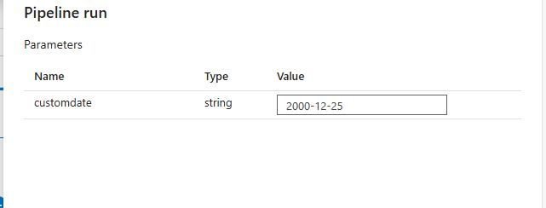

Slide 9
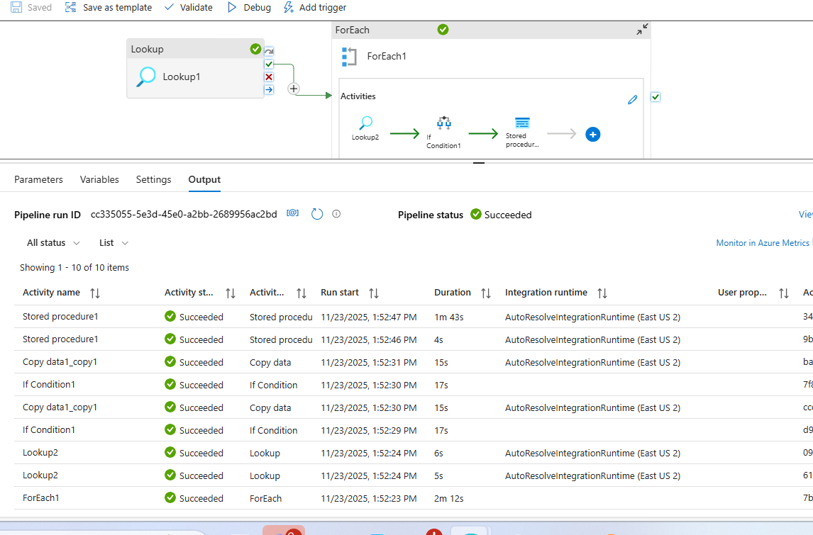

Slide 10
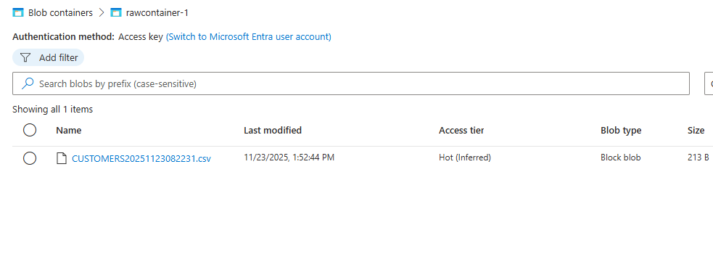

Slide 11
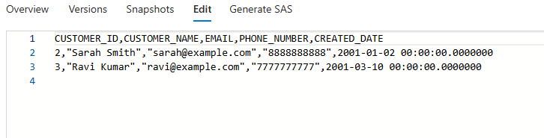
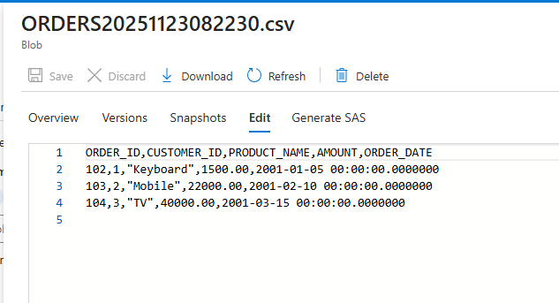
The Data is only select from the table date> custom provided date.

Slide 12
This works for incremental loads as well. The Control table is updated with latest time. It Incremental load as well.

Slide 13
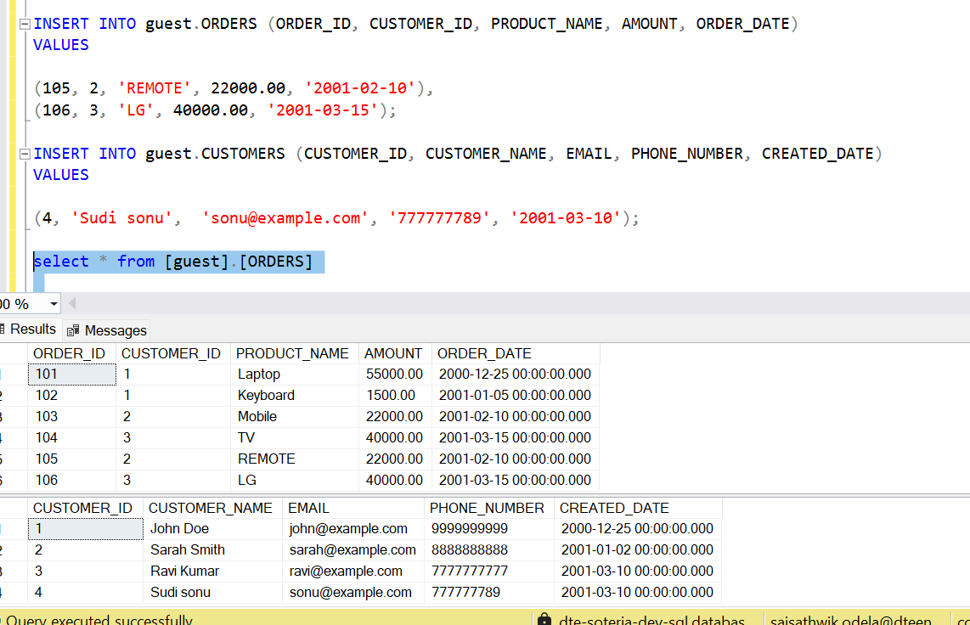

Slide 14
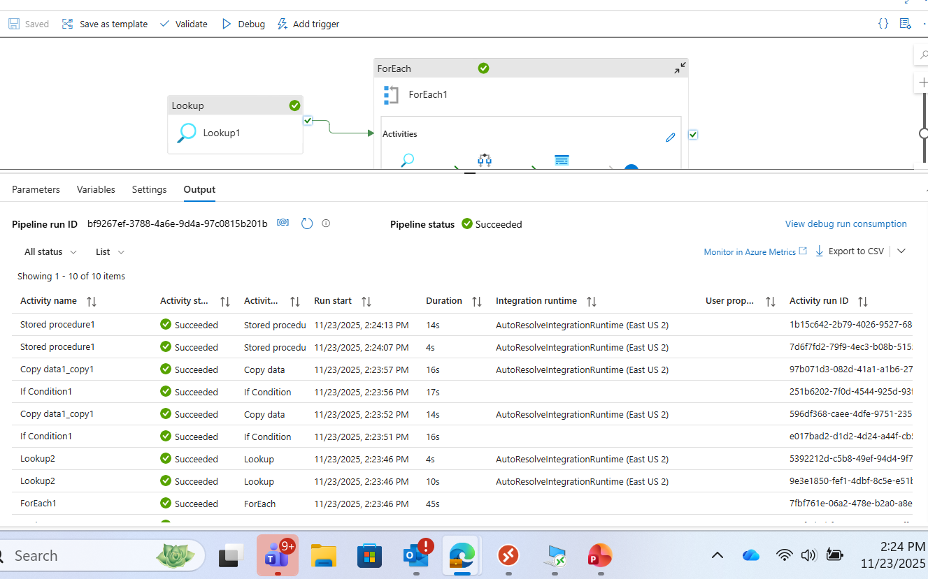

Slide 15
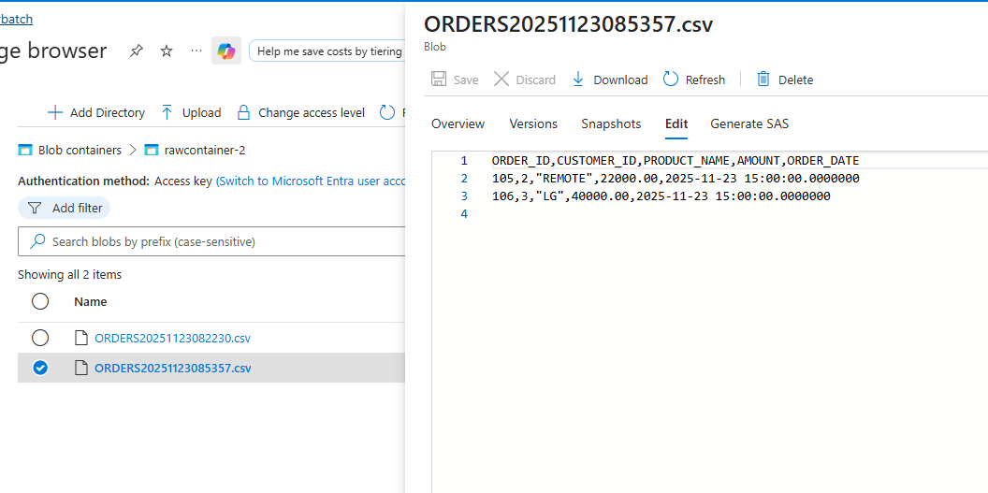

Slide 16
Advantages:
Dynamic Query Generation
  Using item() and pipeline().parameters allows dynamic schema, table, and column selection without hardcoding.
  Reduces maintenance effort when adding new tables or schemas.
Parameterization for Flexibility
  The customdate parameter provides control over incremental loads (watermark logic).
  Easy to override for backfill or custom runs.
Incremental Data Loading
  The WHERE clause with watermark ensures only new or changed records are processed.
  Improves performance and reduces unnecessary data movement.
Scalability
  Works well with ForEach activity to iterate over multiple tables.
  Can handle large datasets by breaking down into smaller, manageable chunks.
Maintainability & Reusability
  Centralized logic for dynamic SQL makes the pipeline reusable across environments.
  Easy to extend for additional tables or columns without redesigning the pipeline.
Error Handling & Logging
  ADF provides built-in activity-level logging and retry policies, making the pipeline robust.

Slide 17
Conclusion
pipeline is designed for efficiency, flexibility, and scalability. By leveraging dynamic content and parameterization, it minimizes hardcoding and supports incremental data loads, which is critical for modern ETL/ELT processes. This approach ensures:
Lower operational overhead
Faster execution times
Adaptability for future changes

